Slide 1

CSD 3102-ARTIFICIAL INTELLIGENCE TECHNIQUES
•
MODULE 3
TOPICS: Knowledge Representation-Knowledge based Agents-The Wumpus World

Slide 2
SYLLABUS
MODULE III KNOWLEDGE AND REASONING 9
Knowledge Representation-Knowledge based Agents-The Wumpus World Logic-Propositional Logic-Predicate Logic-Unification and Lifting - Representing Knowledge using Rules-Semantic Networks Frame Systems Inference – Types of Reasoning.

Slide 3
Reasoning Agents
goal-based agent
Sensors
State
How the world evolves
What the world is like now
What my actions do
What it will be like if I do action A
Environment
Goals
What action I should do now
Agent
Actuators

Slide 4
(Knowledge-based) Reasoning Agents
Know about the world. They maintain a collection of facts (statements) about the world, their Knowledge Base, expressed in some formal language
Reason about the world. They are able to derive new facts from those in the KB using some inference mechanism
Act upon the world. They map percepts to actions by querying and updating the KB

Slide 5
Automated Reasoning
Main Assumption
Facts about the world can be represented as particular configurations of symbols (*)
Reasoning about the world can be achieved by mere symbol manipulation
Most AI researchers believe that reasoning is symbol manipulation, nothing else (after all, the human brain is a physical system itself)
(*) I.e., physical entities such as marks on a piece of paper, states in a computer’s memory, and so on

Slide 6
Abstraction Levels
We can describe every reasoning agent (natural or not) at two different abstraction levels :
Knowledge level: what the agent knows and what the agent’s goals are
Symbol (or implementation) level: what symbols the agent manipulates and how
Agent’s Knowledge and
Goals
reasoning
Agent’s Knowledge and
Goals
Knowledge Level
Internal configuration of symbols
symbol manipulation
Internal configuration of symbols
Symbol Level

Slide 7
Abstraction Levels
We can describe every reasoning agent (natural or not) at two different abstraction levels :
Knowledge level: what the agent knows and what the agent’s goals are
Symbol (or implementation) level: what symbols the agent manipulates and how
At least for artificial agents,
the knowledge level is a metaphor for explaining the behavior of the agent, which is really at the symbol level

Slide 8
Knowledge bases
Inference engine
domain−independent algorithms
Knowledge base
domain−specific content
Knowledge base (KB) = set of sentences in a formal language
Declarative approach to building an agent (or other system):
TELL it what it needs to know Then it can ASK itself what to do
Answers are consequences of the KB

Slide 9
A simple knowledge-based agent
function KB-AGENT( percept) returns an action
static: KB, a knowledge base
t, a counter, initially 0, indicating time
TELL(KB, MAKE-PERCEPT-SENTENCE( percept, t))
action ← ASK(KB, MAKE-ACTION-QUERY(t))
TELL(KB, MAKE-ACTION-SENTENCE(action, t))
t ← t + 1
return action
The agent must be able to:
Represent states, actions, etc.
Incorporate new percepts
Update internal representations of the world
Deduce hidden properties of the world
Deduce appropriate actions

Slide 10
Architecture of a knowledge-based agent
The structural framework of a knowledge-based agent primarily bifurcates into two key sections: the knowledge base and the inference engine.
Knowledge base
The knowledge base acts as a repository of facts, rules, processes, and other necessary data that the agent uses to guide its decision-making process. The knowledge base contains data from the past experiences of the agent as well as knowledge of the world, its environment, and other factors the agent is trained for.
Inference engine
The inference engine is the agent's component that applies logical rules to the knowledge base to deduce additional information. It essentially acts as a system of logical deduction that utilizes the contents of the knowledge base to reach decisions.
These two components collaborate to enable the agent to observe its environment, interpret the input, and ascertain the correct action based on its knowledge and logical deduction capabilities.

Slide 11
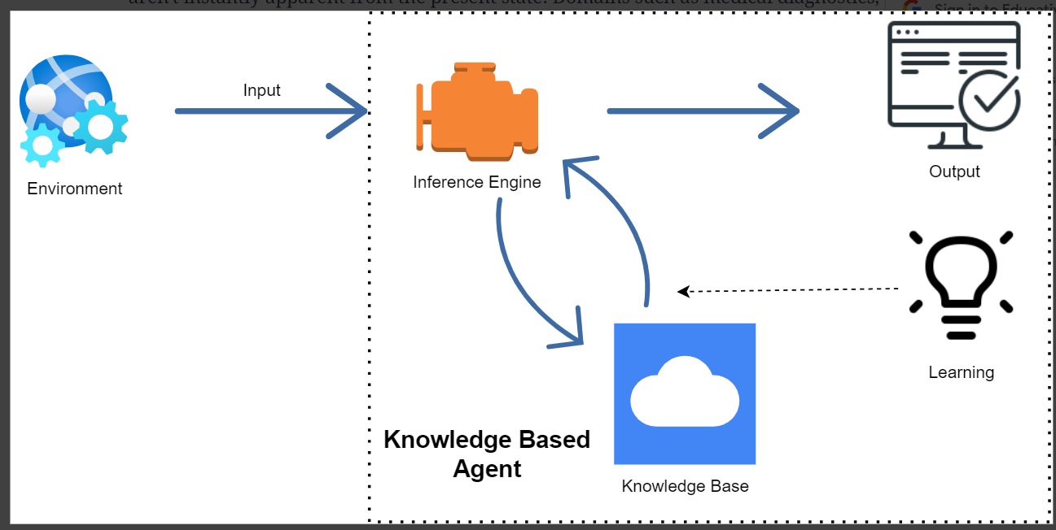
Architecture of a knowledge-based agent

Slide 12
Operational mechanism
The operational mechanism of a knowledge-based agent can be segmented into the following steps:
Environment perception: The agent's operation commences with it observing its environment, which could be via sensors or other input reception methods.
Knowledge base modification: Based on the observed input, the agent subsequently modifies its knowledge base. This could entail introducing new information, revising existing data, or discarding obsolete information.
Inference engine application: After updating the knowledge base, the inference engine comes into play. This engine applies logical rules to extract new facts or infer new data from the knowledge base.
Action determination: Depending on the output of the inference engine, the agent decides on the most suitable action. This action is then implemented within the environment.
Learning from outcomes: Finally, the agent gains insight from the outcomes of its actions. It uses this feedback to modify its knowledge base and hone its future decision-making process.

Slide 13
Levels of Knowledge-based Agent
The knowledge-based agent can be described using three levels. These are:
Knowledge level
Logical level
Implementation level
1. Knowledge level
This is the basic and the most abstract level in a knowledge-based agent. This level describes the agent by what it knows, i.e. through its knowledge base. In this level, the information that the agent has, its goals and the utility are defined.
Example
A house cleaning agent knows where the mop is and where the floor is and where the cleaning material like the soap and detergents are kept. All this is defined in the knowledge level.

Slide 14
Levels of Knowledge-based Agent
2. Logical level
In the logical level, the raw and discrete information which is present in the knowledge level is encoded into sentences. In simple words, the agent in this level derives the logic out of the knowledge base according to the problem. It selects the required blocks of information and combines them meaningfully so as a decision could be made.
Example
The house cleaning agent on getting all the information then checks and finds the place which is dirty and should be cleaned.
3. Implementation level
This is the final layer of the knowledge-based agent. In the implementation level, the logic which the agent has derived in the logical level is brought to implementation. This layer deals with the physical representation of the sentences.
Example
The cleaning agent after finding the place to clean finally takes action and cleans the dirt on the floor and as a result, the agent gets clean floor which is the goal state that the agent is designed to achieve.

Slide 15



An Example: The Wumpus World!
Performance measure:
gold +1000, death -1000,
-1 per step, -10 for using the arrow
Environment:
Squares adjacent to wumpus are smelly Squares adjacent to pit are breezy Glitter iff gold is in the same square
Shooting kills wumpus if you are facing it
Shooting uses up the only arrow Grabbing picks up gold if in same square Releasing drops the gold in same square
Stench |  | Breeze | PIT
 | Breeze Stench Gold | PIT | Breeze
Stench |  | Breeze
START | Breeze | PIT | Breeze
4
3
2
Actuators: Left turn, Right turn, Forward, Grab, Release, Shoot
1
Sensors: Breeze, Glitter, Smell
1
2
3
4

Slide 16
Wumpus World Characterization
Observable?
Partially—only local perception
Deterministic? Yes—outcomes exactly specified Episodic? No—sequential at the level of actions Static? Yes—Wumpus and Pits do not move Discrete? Yes
Single-agent? Yes—Wumpus is essentially a natural feature

Slide 17
Exploring a Wumpus World
OK
OK A | OK

Slide 18
Exploring a Wumpus World
B
OK
A
OK
OK
A

Slide 19
Exploring a Wumpus World
P?
B
OK
P?
A
OK
OK
A

Slide 20
Exploring a Wumpus World
P?
B
OK
P?
A
OK
S
OK
A
A

Slide 21
Exploring a Wumpus World
P?
P
B
OK
P? OK
A
OK
A
S
OK
A
W

Slide 22
Exploring a Wumpus World
P?
P
B
OK
P? OK
A
A
OK
A
S
OK
A
W

Slide 23
Exploring a Wumpus World
P?
P
OK
B
OK
P? OK
OK
A
A
OK
A
S
OK
A
W

Slide 24
Exploring a Wumpus World
P?
P
OK
B
OK
P? BGS OK OK
A
A
A
OK
A
S
OK
A
W

Slide 25
Exploring a Wumpus World
1,4 | 2,4 | 3,4 | 4,4
1,3 | 2,3 | 3,3 | 4,3
1,2 OK | 2,2 | 3,2 | 4,2
1,1 A OK | 2,1 OK | 3,1 | 4,1
^{A} = Agent
^{B} = Breeze
^{G} = Glitter, Gold
^{OK} = Safe square
^{P} = Pit
^{S} = Stench
^{V} = Visited
^{W} = Wumpus
1,4 | 2,4 | 3,4 | 4,4
1,3 | 2,3 | 3,3 | 4,3
1,2 | 2,2 P? | 3,2 | 4,2
OK
1,1 V OK | 2,1 _{A} B OK | 3,1 _{P?} | 4,1
(a)
(b)
•
What are the safe moves from (1,1)?
Move to (1,2), (2,1), or stay in (1,1)
Move to (2,1) then
What are the safe moves from (2,1)?
B in (2,1) ⇒ P in (2,2) or (3,1)
Move to (1,2) then
•
•
•

Slide 26
Exploring a Wumpus World
1,4 | 2,4 | 3,4 | 4,4
1,3 _{W!} | 2,3 | 3,3 | 4,3
1,2 _{A} S OK | 2,2 OK | 3,2 | 4,2
1,1 V OK | 2,1 _{B} V OK | 3,1 _{P!} | 4,1
^{A} = Agent
^{B} = Breeze
^{G} = Glitter, Gold
^{OK} = Safe square
1,4 | 2,4 P? | 3,4 | 4,4
1,3 _{W!} | 2,3 _{A} S G B | 3,3 _{P?} | 4,3
1,2 _{S} V OK | 2,2 V OK | 3,2 | 4,2
1,1 V OK | 2,1 _{B} V OK | 3,1 _{P!} | 4,1
P S V W
= Pit
= Stench
= Visited
= Wumpus
(a)
(b)

 S in (1,2) ⇒ W in (1,1) or (2,2) or (1,3)

•
 Survived in (1,1) and no S in (2,1) ⇒ W in (1,3)
 No B in (1,2) ⇒ P in (3,1) Move to (2,2), then to (2,3)
G in (2,3)
Grab G and come home
•
•
•

Slide 27
Other Considerations
Probabilistic Reasoning
P?
B OK
P?
P?
A
OK B OK
P?
A
A
Breeze in (1,2) and (2,1) =⇒ no safe actions
Assuming pits uniformly distributed, (2,2) has pit w/ prob 0.86, vs. 0.31

